Slide 1
Senior Career Options
Alasdair Reid
Careers Adviser - Skills Development Scotland

Slide 2
What we do
Advice, support and guidance for S3 – S6 Pupils
Application support – college, job, university
Explore options
Signpost information

Slide 3
What does this support look like for Students
Group Engagements-
One to one support- Guidance referral.
One to one support – Student referral.
Sometimes student's goals can be met in one session (45 minutes) but more often than not it can take multiple sessions

Slide 4
Options end of S4
Return to School for S5
College
Apprenticeships
Employment
Winter Leavers (Born after 1st October)

Slide 5
Options end of S5
Return to school for S6
College
University
Apprenticeships
Employment

Slide 6
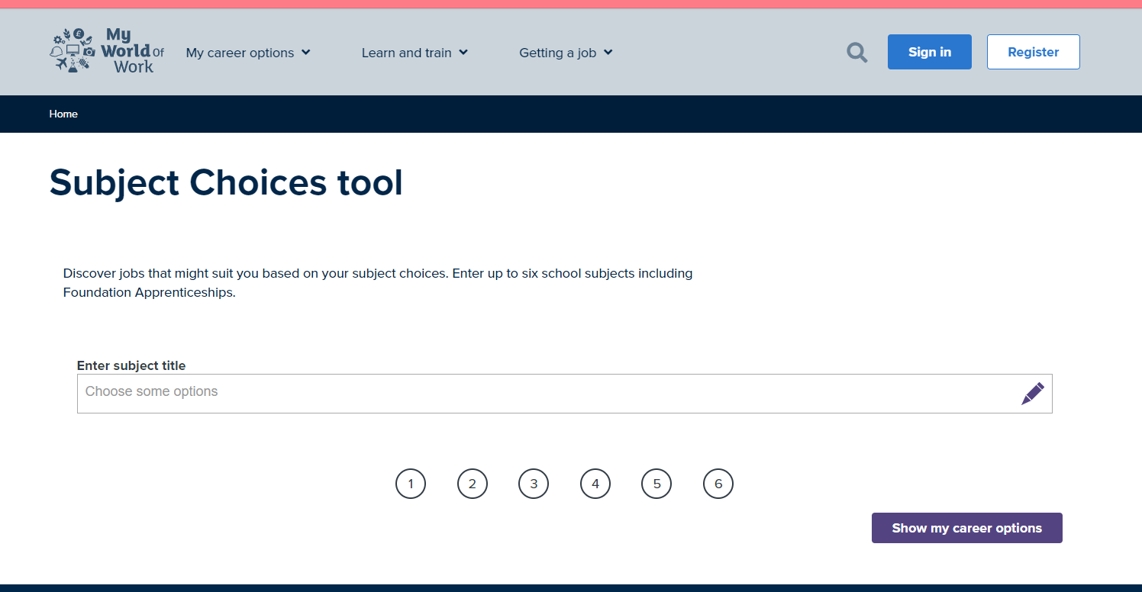
Subject Choice Tool on My World of Work
https://www.myworldofwork.co.uk/tools/subject-choices

Slide 7
How to get in touch
Email
Alasdair.reid@sds.co.uk
Text or Phone
07825034964
Perth Office - Phone
01738 637639
In Person
Room 33a (English Corridor)

Slide 8
Where to find more information
Apprenticeships.scot
Ucas.com
College Sites;
https://www.perth.uhi.ac.uk/
https://www.fife.ac.uk/
https://www.forthvalley.ac.uk/
https://dundeeandangus.ac.uk/
Job Search Sites;
Indeed.co.uk
S1 Jobs
Reed.co.uk
PA Pathways Twitter Page
twitter.com/PAFuturePathway

Slide 9
Thank you!

