Slide 1


Schools College Partnership

Slide 2

Courses
SCQF Level 3
Introduction to Beauty Skills
Introduction to Hairdressing
SCQF Level 4
Passport to Childcare
NPA Beauty Skills
SFW Hairdressing National 4
NPA Bakery
Motor Vehicle Technology Workshop Skills
Construction Crafts Multi Skills
SFW Engineering Skills
NPA Science and Health
SCQF Level 4/5
ESOL Pathways to FE
Subject to change. Please check our website.

Slide 3
Courses
SCQF Level 5
SFW Hairdressing National 5
SFW Health Sector National 5
NPA Criminology
National 5 Psychology
NPA Computer Games Development
Professional Cookery Come Dine with Me
NPA Sport and Fitness: Outdoor Sport
SFW Sport and Recreation
NPA Engineering
SCQF Level 4/6
Cyber Security Fundamentals
and Network Literacy
Subject to change. Please check our website.

Slide 4
Courses
SCQF Level 6
Higher Childcare and Development
SFW Higher Beauty
Higher Psychology
NPA Criminology
NPA Computer Games Development
NPA Hospitality Operations
NQ Activity Tourism
NPA Music Business
Higher Music Technology
Foundation Apprenticeships
SCQF Level 7
IT in Business: Word Processing and Presentations
PDA Modern Biological Technologies
Subject to change. Please check our website.

Slide 5

Study modes
Online
Face to Face at UHI Perth
Blended
School

Slide 6
What should I consider?
Experience College/University learning as part of your school timetable
Gain skills and confidence
Boost CV
Add to school qualifications
Decide on a career path
Travel time
Consider all subjects
Check University entry requirements
Speak with Guidance Teacher, Parent/ Carer or College Staff

Slide 7

Feedback from pupils
“It’s good to learn about a new topic which I find interesting and is not available at school.” Esme
“I am enjoying the course so far and the best parts are how nice our tutors and lecturers are, as well as getting to mix with pupils from different schools and year groups.” Holly
“I chose this course because it looked interesting, and I felt like the course would help me in life. I am enjoying the course and I like learning new things in this environment.” Malcolm

Slide 8

Foundation Apprenticeships

Slide 9
What is a Foundation Apprenticeship?
Study at College and the workplace 1 day per week (usually Friday).
Work based learning course
SCQF Level 6
UCAS
Work Experience
Study over 1 or 2 years in S5 and S6
 | Year 1 (S5) | Year 2 (S6)
Foundation Apprenticeship | NC/NPA | + SVQ Units = Foundation Apprenticeship
At School | National 5/Highers | National 5/Highers

Slide 10

Foundation Apprenticeships
One Year FAs
FA Financial Services
FA Social Services and Healthcare
FA Social Services Children and Young People
Two Year FAs
FA Creative and Digital Media
FA Social Services and Healthcare
FA Social Services Children and Young People
.
Subject to change. Please check our website.

Slide 11
Why consider an FA?
Get the skills employers are looking for
Transferable skills
Wider career choices
Employer Networking
Progress to work, MA/GA, HNC/HND or University
UCAS Points
Travel – free with NEC
Speak with Guidance Teacher, Parent/ Carer or UHI Perth Staff to find out more.

Slide 12
Employers
Aviva
SSE
NHS
Air Service Training
Academy of Sport and Wellbeing
Culture Perth and Kinross
Willowgate Activity Centre
Kythe Kinross
W.A. McGarrie
Honeypot Nurseries
Stagecoach
Heartland FM
Capability Scotland
NHS
RSPB Kinross
Scottish Crannog Centre

Slide 13
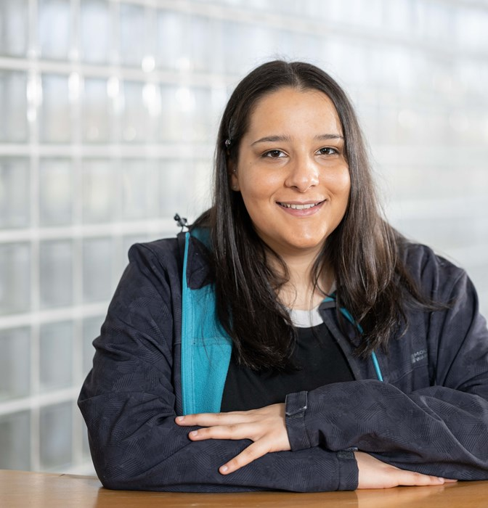
Lara’s Story
“Through the guidelines I learned via my apprenticeship, I was able to do my job in a safe manner.... I also applied my apprenticeship learning just by adopting to be reflective and being more knowledgeable about the way of practice and how to hold professional relationships with patients which are kind, friendly and welcoming - person-centred care.”
Lara’s apprenticeship has influenced her progression from high school and college (FA) to university, more specifically the University of Aberdeen where she now studies a degree in the Master of the Arts Psychology and two electives in Sociology and Philosophy.

Slide 14
Entry Requirements
Foundation Apprenticeship | Entry Requirements
Social Services Children and Young People | National 5 English or working towards it. National 5 Mathematics or Life Skills
Social Services and Healthcare | National 5 English or working towards it. National 5 Mathematics or Life Skills
Financial Services | National 5 English or working towards it. National 5 Mathematics or Life Skills
Creative and Digital Media | Able to work at SCQF Level 6

Slide 15

How to Apply
Speak with your Guidance Teacher
Visit perth.uhi.ac.uk/schools
Find your course and check entry requirements
Complete online application
School Course/Option Choice
Interview for some courses
Courses start June 2024

Slide 16

Why choose UHI Perth

Slide 17
Progression
3 Highers
Degree
School
Leavers
2 Highers
HND
1 Higher
HNC
National 5’s
National Qualifications

Slide 18
Subject Areas
Administration and IT
Air Service Training
Audio Engineering
Beauty Therapy
Built Environment
Business and Accounting
Centre for Mountain Studies
Computing
Creative Industries
Early Education and Childcare
Engineering and Aviation
Food Studies and Hospitality
Hairdressing
Health and Social Care
Horticulture
Humanities and Social Sciences
Language School
Management
Microsoft Office Specialist
Modern Apprenticeships
Motor Vehicle
Music and Music Business
New Opportunities
Science
Social and Vocational Studies
Sport and Fitness
Theatre Arts

Slide 19

More Information
Visit our Open Days – next one in January!
Schools Courses
www.perth.uhi.ac.uk/schools or email schools.perth@uhi.ac.uk or speak with your Guidance Teacher or SDS Careers Adviser

Slide 20

Thank You

