Slide 1
S2 Course Choice
Alasdair Reid
Careers Adviser - Skills Development Scotland

Slide 2
What we do
Advice, support and guidance for S1 – S6 Pupils
Application support – college, job, university
Explore options
Signpost information

Slide 3
Perth Academy S2 Support
One to One session for every S2
Group session delivered during PSE based around decision making
Parental Support at Parents Evening (Other arrangements made this year)

Slide 4
Advice for S2’s
Think about the subjects you enjoy
Consider where you want to be in the future
Keep your options open
Research subjects in advance
Talk to people

Slide 5
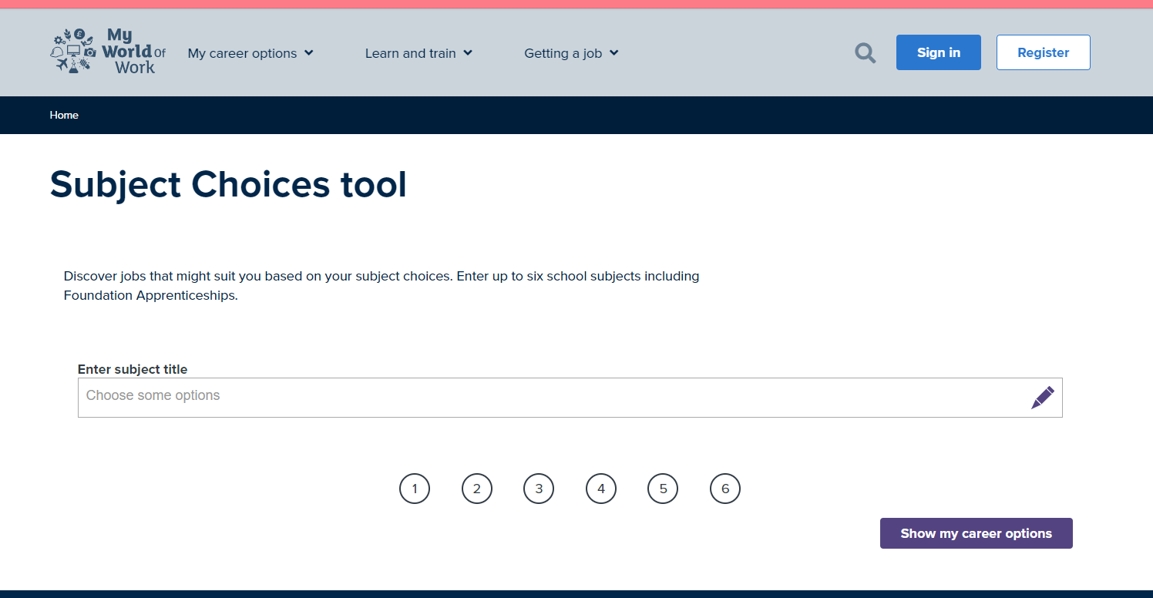
Subject Choice Tool on My World of Work
https://www.myworldofwork.co.uk/tools/subject-choices

Slide 6
Options after school
College
University
Apprenticeships
Employment
Training

Slide 7
How to get in touch
Email
Alasdair.reid@sds.co.uk
Text or Phone
07825034964
Perth Office - Phone
01738 637639

Slide 8
Where to find more information
Apprenticeships.scot
Ucas.com
College Sites;
https://www.perth.uhi.ac.uk/
https://www.fife.ac.uk/
https://www.forthvalley.ac.uk/
https://dundeeandangus.ac.uk/
Job Search Sites;
Indeed.co.uk
S1 Jobs
Reed.co.uk
PA Pathways Twitter Page
twitter.com/PAFuturePathway

Slide 9
Thank you!

